Slide 1

Oracle Final Project
La’quan Morris, Hannah Wallace, & Breydon Brennan

Slide 2
Premise of the Final Project
Three tables: customers, products, sales
Customers: First & Last Name, Address, City, State, etc.
Products: Product name, Price, Stock, Seller, etc.
Sales: Combination of the two, order date, order number
Primary Keys and Foreign Keys
Primary Key: CustomerID / ProductID
Foreign Keys: Consult UML Diagram on next slide

Slide 3
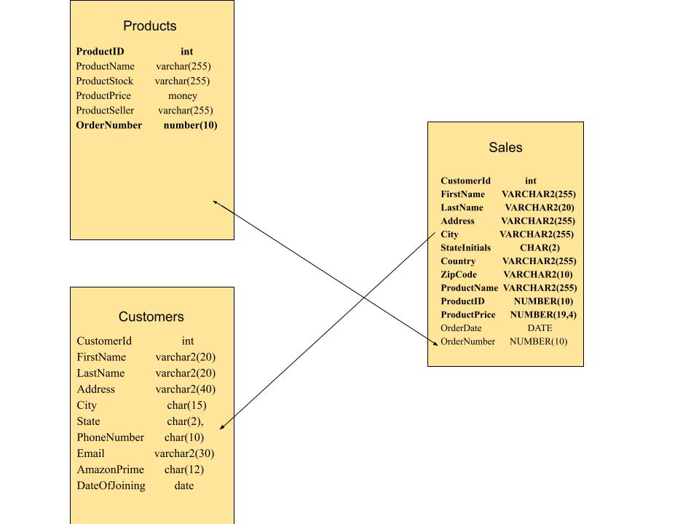
UML Diagram

Slide 4
Creating the Customer Table
Customer ID, basic contact information, Amazon Prime Membership, & date of joining
We do not need a foreign key for this because:
No references to any purchases
No references to products are needed
Sequence must be created to auto increment the Customer ID
Range of 100 – 200 and increment by 1
Synonym can also be created to simplify the code

Slide 5
Customer Table Code
CREATE TABLE Customer(
CustomerId int primary key,
FirstName varchar2(20),
LastName varchar2(20),
Address varchar2(40),
City char(15),
State char(2),
PhoneNumber char(10),
Email varchar2(30),
AmazonPrime char(12),
DateOfJoining date default sysdate
);
Adding Sequence: CREATE SEQUENCE c_seq start with 101 increment by 1 maxvalue 200 nocycle nocache;
Adding Synonym: CREATE SYNONYM c FOR CUSTOMER;

Slide 6
Our Amazon Customers
We have 5 customers in our initial database:
Timmy Turner
John Cena
Peter Parker
Santa Claus
Porky Pig

Slide 7
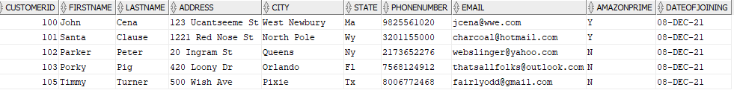
Populating Data into Table
INSERT INTO c VALUES(100,'John', 'Cena', '123 Ucantseeme St', 'West Newbury', 'Ma', '9825561020', 'jcena@wwe.com', 'Y', sysdate);
After we put our first element into the table, we can then use the c_seq.nextval in place of CustomerID

Slide 8
Creating the Products Table
Very similar process to customer table
Product ID, Product Stock, Seller, Price, Product Name
Synonym should also be created
We do not need a sequence or a foreign key
Adding Product ID manually
Does not refer to anything from another table

Slide 9
Creating Table Code
CREATE TABLE products (
ProductID int NOT NULL,
ProductName varchar(255),
ProductStock varchar(255),
ProductPrice NUMBER(19,4),
ProductSeller varchar(255),
PRIMARY KEY (ProductID)
);
Adding Synonym: CREATE SYNONYM p FOR PRODUCTS;

Slide 10
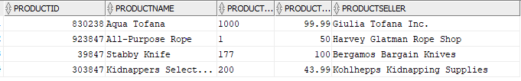
Populating Data in Products
INSERT INTO p VALUES (8300238, ‘Aqua Tofana’, ‘1000’, 99.99, ‘Giulia Tofana Inc.”);

Slide 11
Creating the Sales Table
Compilation of products and customers
First & Last names, Addresses, Product Names, Product ID, Order Date, etc.
Foreign Key includes customer and product table:
Cannot have a sale without a customer and a product
Ties references around both tables
Sales are very important, using two foreign keys adds a layer of redundancy
Sequence and Synonyms need to be created

Slide 12
Creating Table Code
CREATE TABLE sales(
CustomerId int NOT NULL PRIMARY KEY,
FirstName VARCHAR2(255) NOT NULL,
LastName VARCHAR2(20) NOT NULL,
Address VARCHAR2(255) NOT NULL,
City VARCHAR2(255) NOT NULL,
StateInitials CHAR(2) NOT NULL,
Country VARCHAR2(255) NOT NULL,
ZipCode VARCHAR2(10) NOT NULL,
ProductName VARCHAR2(255) NOT NULL,
ItemNumber NUMBER(10) NOT NULL,
ProductPrice NUMBER(19,4) NOT NULL,
OrderDate DATE NOT NULL,
OrderNumber NUMBER(10) NOT NULL,
CONSTRAINT sales_customer_fk FOREIGN KEY(CustomerId) REFERENCES Customers(CustomerID),
CONSTRAINT sales_products_fk FOREIGN KEY(ItemNumber) REFERENCES products(ProductID)
);
CREATE SYNONYM s FOR SALES;
CREATE SEQUENCE s_seq start with 101 increment by 1 maxvalue 200 nocycle nocache;

Slide 13
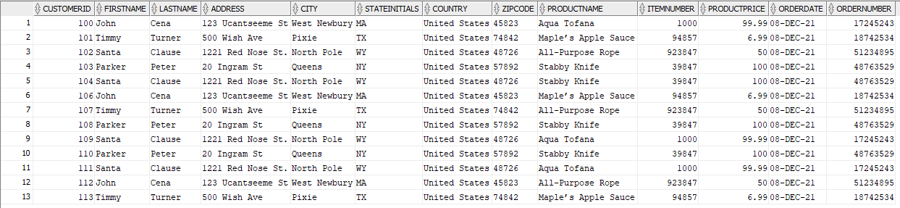
Populating Data in Sales
INSERT INTO s VALUES(100, 'John', 'Cena', '123 Ucantseeme St', 'West Newbury', 'MA', 'United States', '45823', 'Aqua Tofana',830238, 99.99, sysdate, 17245243);
We can use s_seq.nextval after the first element is entered to implement the sequence

Slide 14
Sales History
CREATE TABLE SalesHistory(
CustomerId int NOT NULL PRIMARY KEY,
FirstName VARCHAR2(255) NOT NULL,
LastName VARCHAR2(20) NOT NULL,
Address VARCHAR2(255) NOT NULL,
City VARCHAR2(255) NOT NULL,
StateInitials CHAR(2) NOT NULL,
Country VARCHAR2(255) NOT NULL,
ZipCode VARCHAR2(10) NOT NULL,
ProductName VARCHAR2(255) NOT NULL,
ItemNumber NUMBER(10) NOT NULL,
ProductPrice NUMBER(19,4) NOT NULL,
OrderDate DATE NOT NULL,
OrderNumber NUMBER(10) NOT NULL
);
INSERT INTO SALESHISTORY SELECT * FROM s WHERE rownum <= 3;

